Slide 1
The Parallela Board
Shashi Bhushan
October 3rd 2016

Slide 2
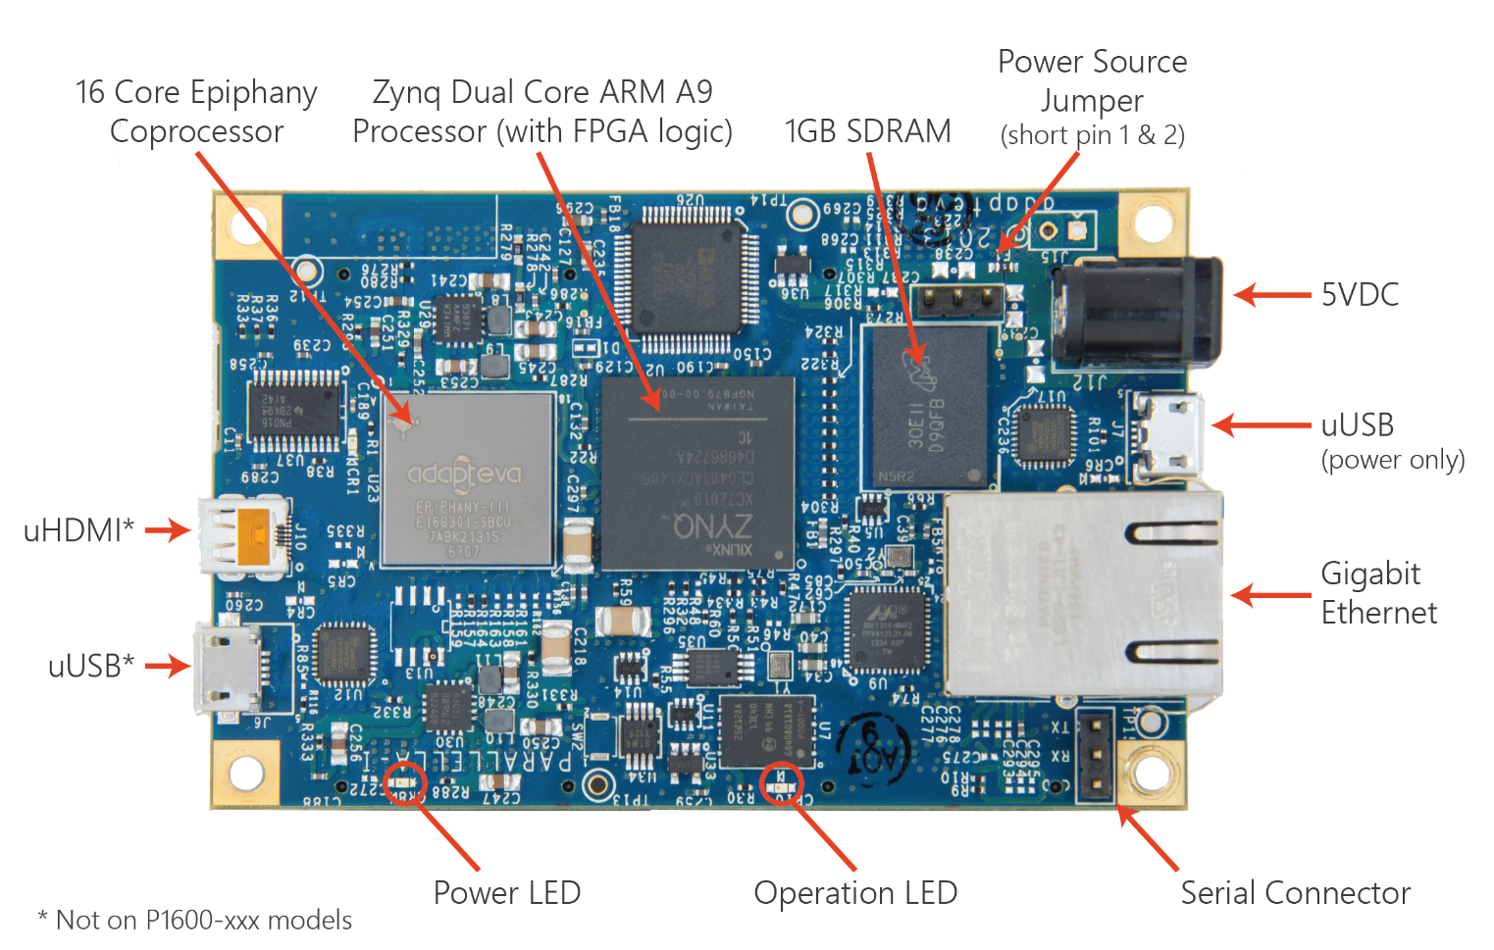
The Parallela Board
• 18-core credit card sized computer • #1 in energy efficiency @ 5W • 16-core Epiphany RISC SOC • Zynq SOC (FPGA + ARM A9) • Gigabit Ethernet • 1GB SDRAM • Micro-SD storage • Up to 48 GPIO pins • HDMI, USB (optional) • Open source design files • Runs Linux

Slide 3
The Parallela Board cont.
A high performance, credit card sized computer based on the Epiphany multi-core chips from Adapteva
Includes a low power dual core ARM A9 processor and runs several of the popular Linux distributions, including Ubuntu
Epiphany co-processor chips consists of a scalable array of simple RISC processors programmable in bare metal C/C++
The co-processor also supports parallel programming frameworks like OpenCL
The mesh of independent cores are connected together with a fast on chip network within a distributed shared memory architecture

Slide 4
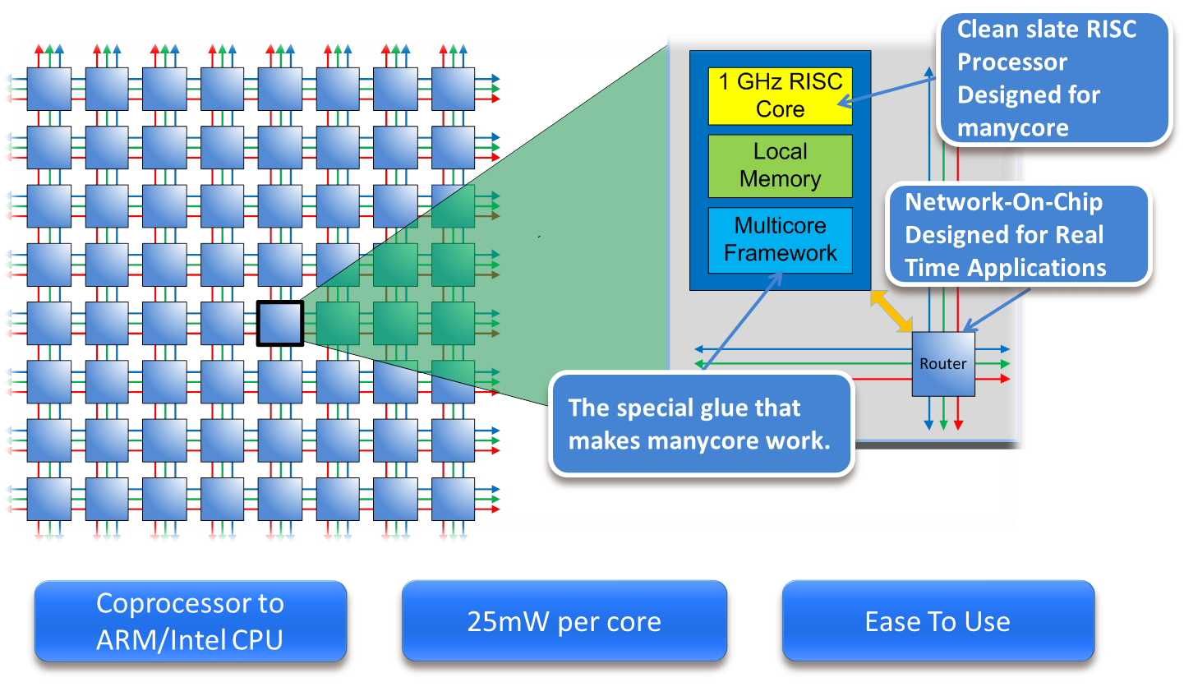
The Epiphany architecture
The Epiphany architecture is a many-core processor design consisting of “tiny” RISC cores connected with a 2D mesh on-chip network
No inter-core bus, no cache (and thus no coherence protocol), and no speculation (not even branch prediction)
The result is an energy-efficient architecture that can achieve up to 70 GFLOPS/Watt and scale to thousands of cores

Slide 5
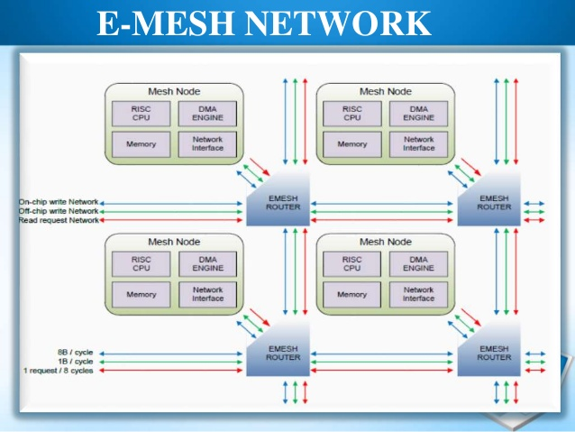
E-Mesh Network
Network sends complete transactions— consisting of source address, destination address, and data—in a single clock cycle
Each routing link can transfer up to 8 bytes of data on every clock cycle.
This allows 64 bytes of data to flow through every routing node on every clock cycle
Thus supports an effective bandwidth of 64 GB/sec at a mesh operating frequency of 1GHz

Slide 6
E-Mesh Network cont.
2D mesh layout of the NoC
Messages are first routed east-west, then north-south
Four eLink routers connect the cores on their north, south, east, and west edges.
Different type of traffic:
One for read: rMesh
One for on-chip write: cMesh
One for off-chip write: xMesh

Slide 7
RISC Cores
Dual-Issue Pipeline : Dual issue means that each clock cycle the processor can move two instructions from one stage of the pipeline to another
One single-precision FPU (32 bits Floating point unit) : Designed to carry out operations on floating point numbers.
Typical operations are addition, subtraction, multiplication, division, square root, and bit shifting
Two integer ALU

Slide 8
Event Timers
Each processor node has two 32-bit event timers that can operate independently to monitor key events within the processor node.
The timers can be used for program debug, program optimization, load balancing, traffic balancing, timeout counting, watchdog timing, system time, and numerous other purposes

Slide 9
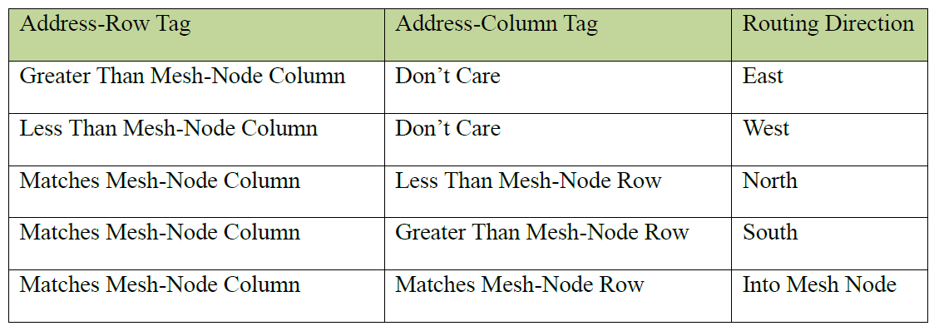
Routing Protocol

Slide 10
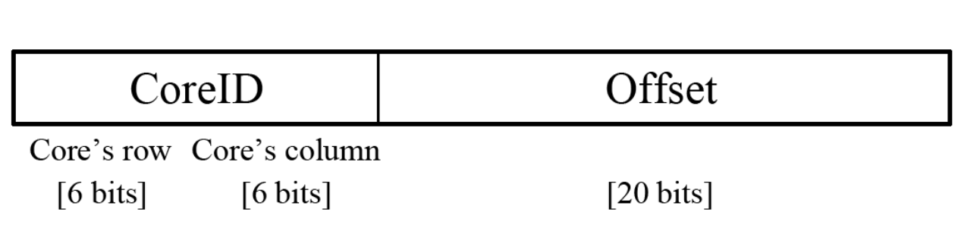
Memory model
Flat and unprotected memory map
Shared, globally addressable 32-bit (4GB) memory address space.
An address is logically divided into the coreID and Offset
Supports up to 4095 cores

Slide 11
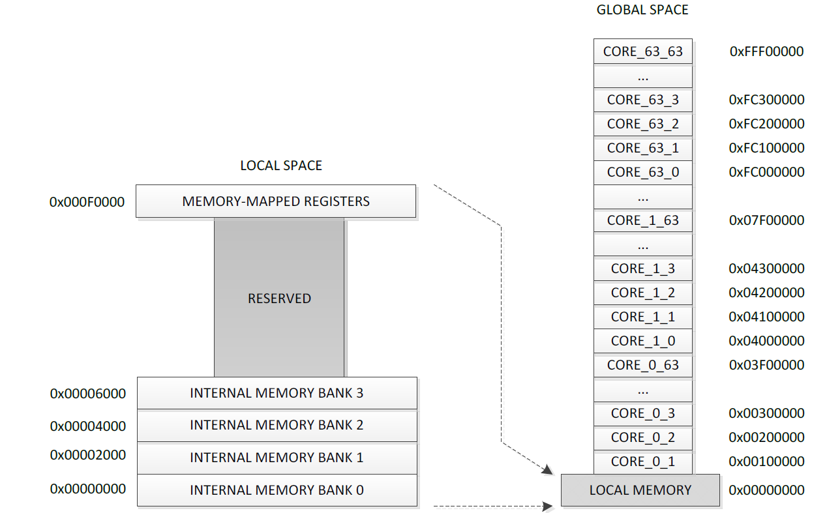
Memory model cont.
64-node region of the memory map

Slide 12
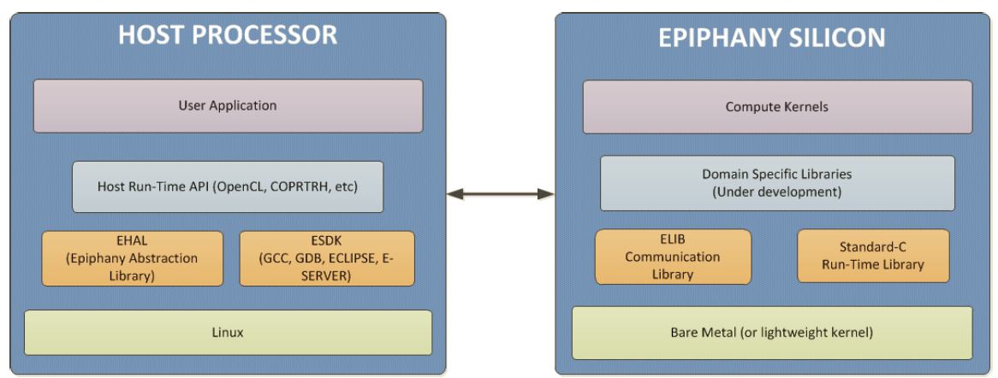
Software Environment
Programming Environment
C/C++
Epiphany SDK (Epiphany Software Development Kit)
The Epiphany SDK includes:
ANSI-C/C++ GCC compiler
OpenCL SDK
Multicore GDB debugger
Eclipse based multicore IDE
Runtime library
Fast functional single core simulator

Slide 13
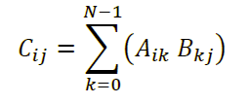
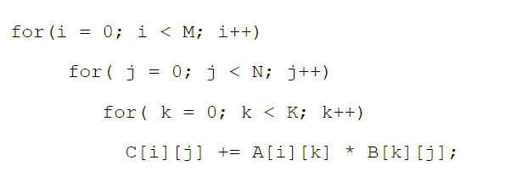
Parallel Programming Example: Matrix Multiplication
General formulae:
Naïve implementation of matrix multiplication

Slide 14
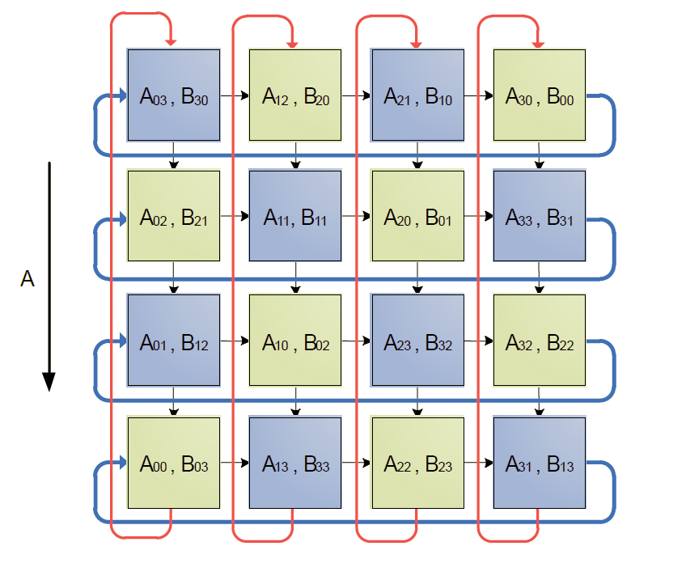
Parallel Programming Example: Matrix Multiplication cont.
The example can be written and compiled to a single core
There will be no difference between epiphany and architecture and any other single threaded processor platform
To speed up this calculation using several mesh nodes simultaneously, we first need to distribute the A, B, C matrices over P tasks.

Slide 15
Parallel Programming Example: Matrix Multiplication cont.
The figure above shows the multiplication divided into 16 sub tasks and
Data sharing between the sub tasks can be done by:
Passing data between the cores using a message passing API provided in the Epiphany SDK or
Explicitly writing to global shared memory. mapped onto 16 mesh nodes
The parallel matrix multiplication completes in √P steps, (where P is the number of processors)
Each matrix multiplication task operating on data sets that are of size √P x √P

Slide 16
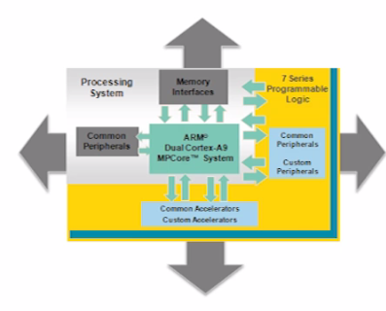
Xilinx Zynq-7000 all Programmable SoC
Integrates the software programmability of an ARM-based processor with the hardware programmability of an FPGA.

Slide 17
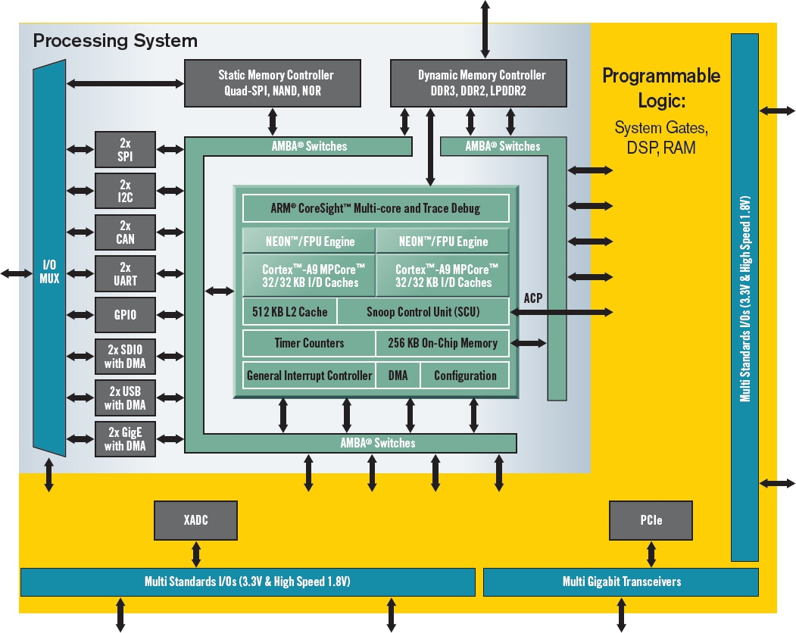
Architecture Diagram

Slide 18
Why is it Important?
First platform to offer Software, Hardware and I/O programmability on a single chip
Software programmability – ARM based processing system through Dual Core Cortex A9
Hardware programmability – Tightly coupled programmable logic
can be used to extend the capability of ARM processor by adding peripherals or accelerators
I/O programmability – Large set of I/O transceivers

Slide 19
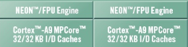
Processing system
The Zynq-700 processing system has 2 Cortex A9 cores
Each core has its own NEON engine(general purpose SIMD) for multimedia processing and Vector floating point engine for advanced arithmetic processing.
Several speed grades up to 1 GHz

Slide 20
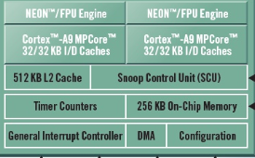
Processing system Cont.
Each processor has its own level 1 data and instruction cache of 32 KB each
Both processors also share 512 KB of level 2 cache
Apart from two level of cache, it also has 256 KB of on-chip memory

Slide 21
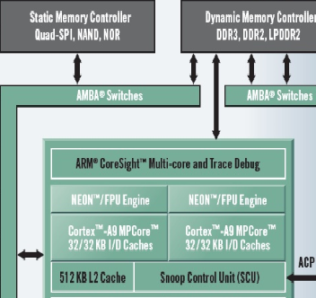
Processing system Cont.
The processing system has dedicated memory controllers to connect to external dynamic memories or static memories
The static memory connected can be used to hold the boot code or to configure the programmable logic

Slide 22
Integrated Peripherals
The Zynq-7000 has a broad set of memory mapped peripherals that can be used to interact with outside world
The peripherals include USB, AMBA, CAN among many others.
It is important to note that all peripherals are in pairs and come with DMA capabilities

Slide 23
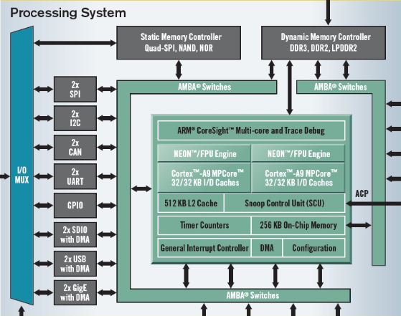
The complete processing system
This complete processing enables most of the operating systems to run on the Zynq devices without the support of any other IP

Slide 24
AMBA Switches and snoop control unit(SCU)
The processing system connects with the programmable logic using the AXI (part of AMBA) interface.
The SCU block connects two cortex-A9 processors to the memory system and can also manage data coherency between the two processors and L2 cache
The Accelerator Coherency Port (ACP) connects the programmable logic to SCU to build accelerators with lowest possible latency

Slide 25

AMBA Switches and snoop control unit(SCU) cont.

Slide 26
Programmable logic
The processing system discussed is complemented with the tightly coupled programmable logic
Shares same programmable logic architecture as Xilinx 7 series FPGAs
Contains up to 900 DSP blocks enabling massive parallel processing
Contains XADC and PCIe blocks apart from multi standard I/O s and multi gigabit transceivers

Slide 27
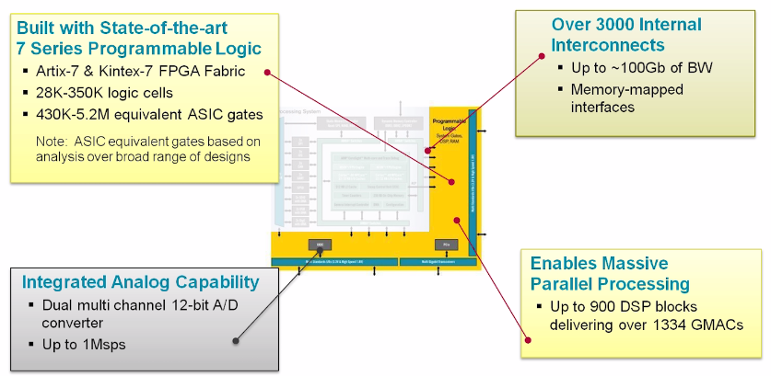
Programmable logic cont.

Slide 28
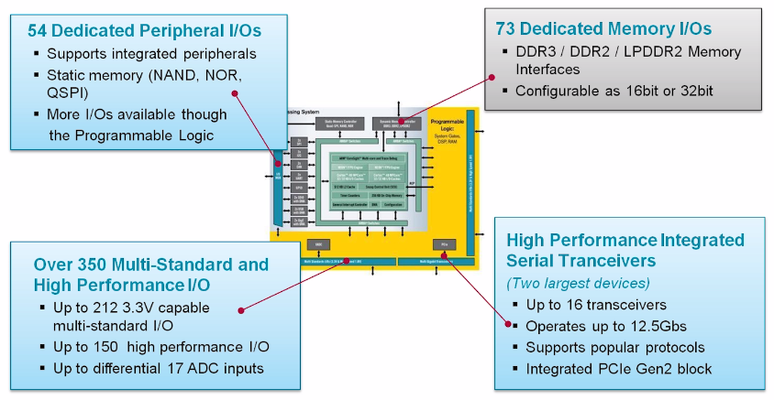
Programmable logic cont.

Slide 29
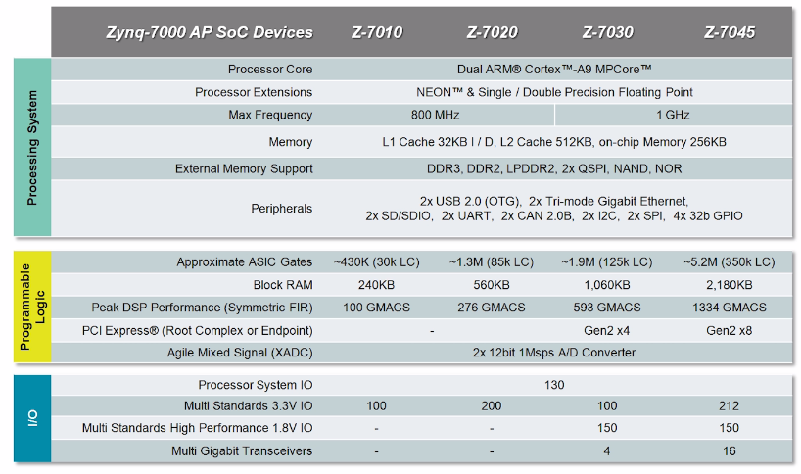
The Family
All Zynq devices has same processing system to provide a common base platform enabling easy migration from one device to another

Slide 30
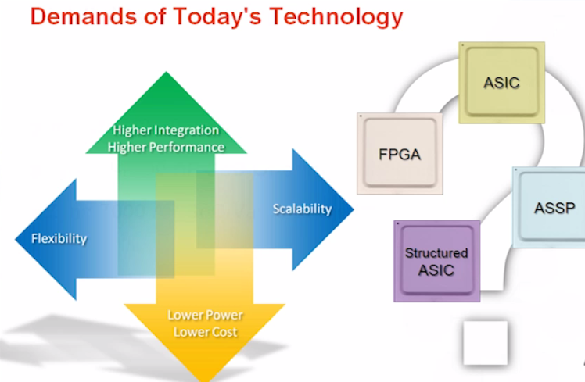
WHY USE ZYNQ
To understand the need of a Zynq like architecture, first we have to understand the demands of today’s technology

Slide 31
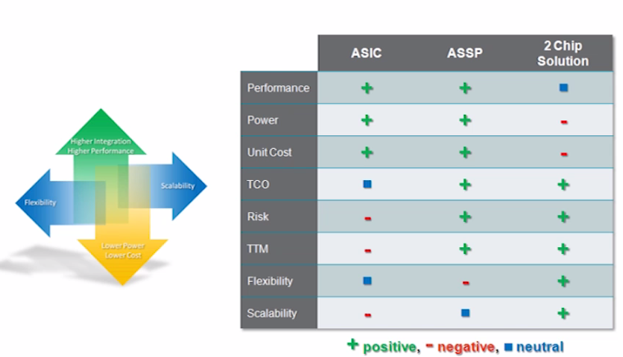
WHY USE ZYNQ cont.
Now that we have understood the demands, let’s discuss the potential solutions and the degree to which they meet the demands

Slide 32
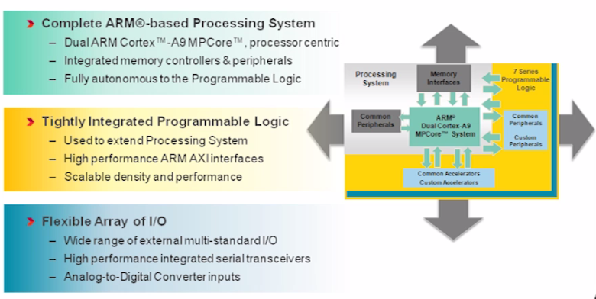
WHY USE ZYNQ cont. : The solution

Slide 33
References
http://www.xilinx.com/video/soc/zynq-hardware-architecture-highlights.html
http://www.xilinx.com/support/documentation/user_guides/ug585-Zynq-7000-TRM.pdf
http://www.xilinx.com/video/soc/why-zynq.html
http://www.xilinx.com/support/documentation/data_sheets/ds190-Zynq-7000-Overview.pdf
http://research.ac.upc.edu/multiprog/multiprog2015/papers/multiprog-2015-13.pdf
www.adapteva.com/docs/epiphany_arch_ref.pdf
http://www.mcs.anl.gov/events/workshops/ashes/2014/slides/ashes14-varghese.pdf
Epiphany Multicore Accelerator PPT_JiekunLu
Xilinx Zynq-7000 PPT_ShashiBhushan

Slide 34
Questions?

